Slide 1
Bright TV Viewership Analysis
Prepared for: Bright TV CVM
Focus: Subscriber Growth & Engagement

Slide 2
Agenda
Introduction
Usage Insights
Consumption Influence
Content Recommendations
Conclusion & Next Steps

Slide 3
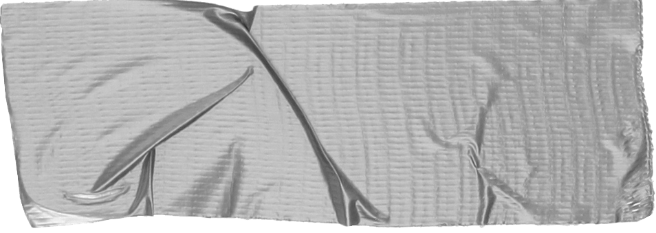

1. Intro
Current subscriber base: 4,386 across 10 regions
Total watch hours: 1,523
Channels available: 17
Audience spans 8 age groups and diverse ethnicities
Objective: Expand subscription base through data-driven strategies

Slide 4
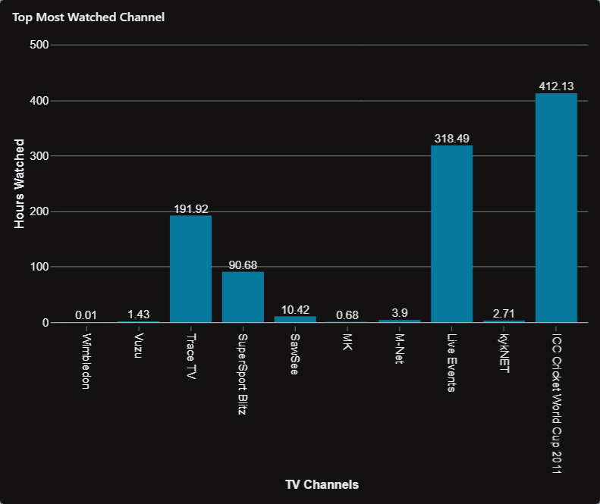
Usage Insights
Top Channels Watched:
ICC Cricket World Cup 2011 (412 hrs)
Live Events (318 hrs)
Channel O (193 hrs)
Trace TV (192 hrs)

Slide 5
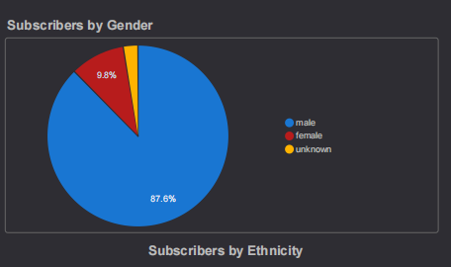
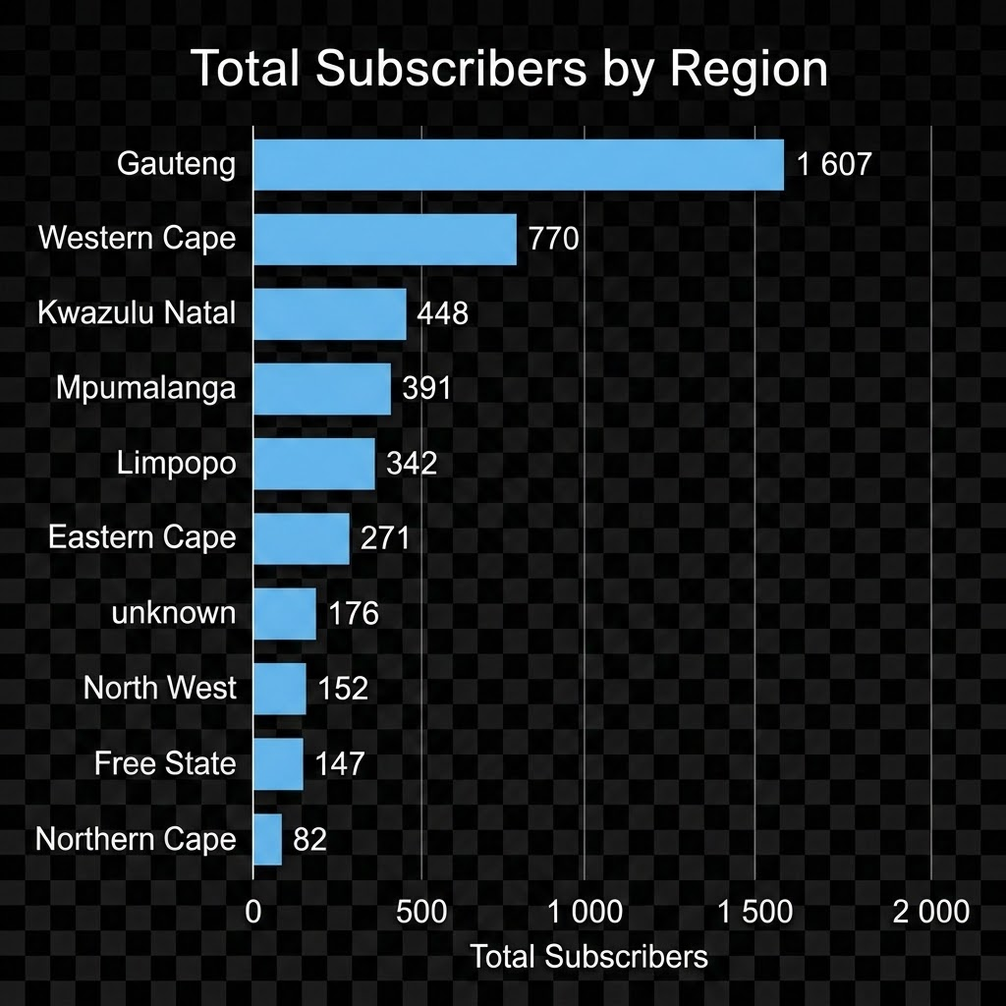
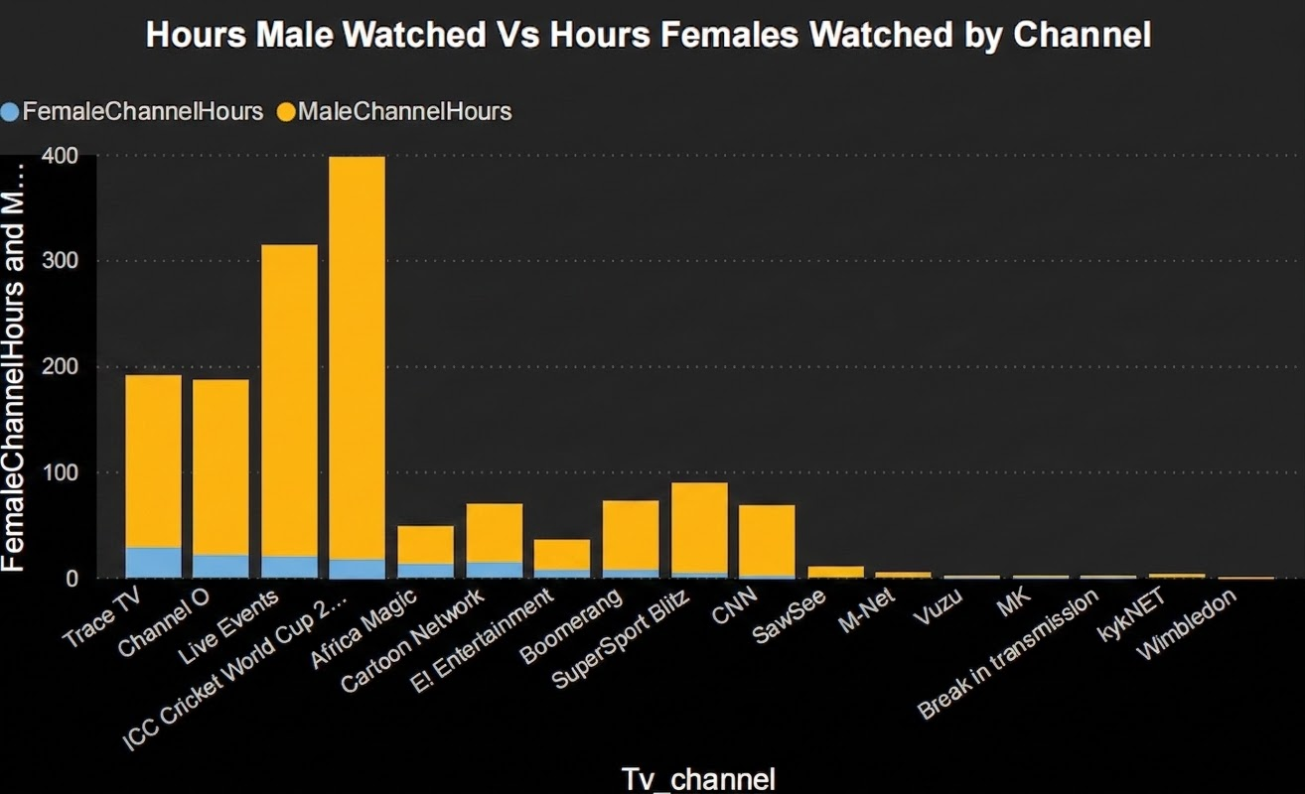
Usage Insights
Regional Distribution:
Gauteng (1,607 subs) and Western Cape (770 subs) lead
Smaller bases in Northern Cape (82 subs) and Free State (147 subs)
Gender Split:
Male watch hours (1,348 hrs) vs Female (139 hrs)

Slide 6
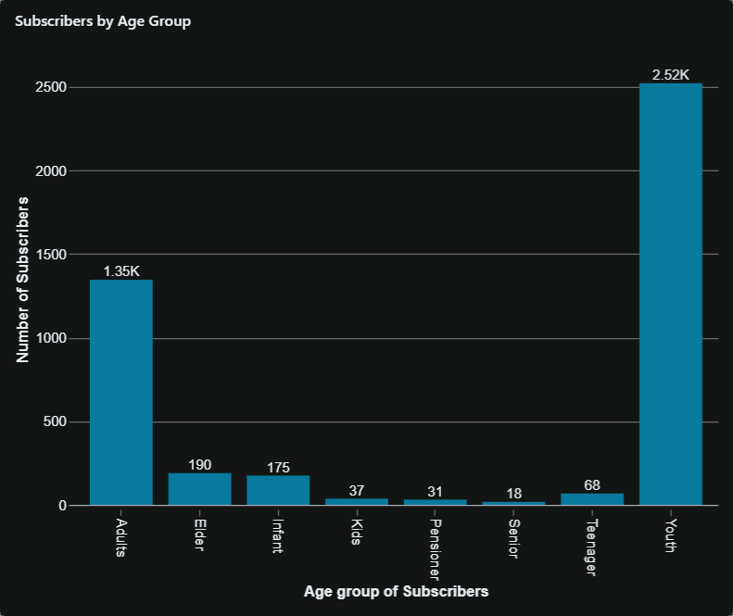
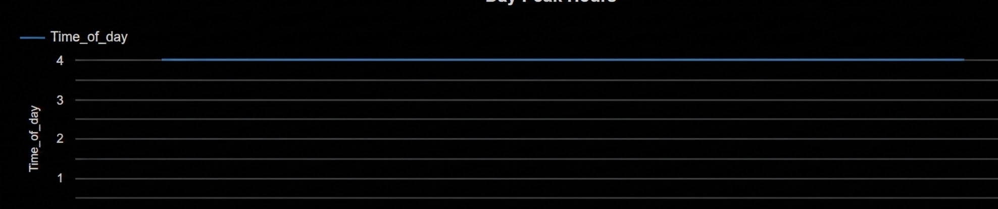
Consumption Influence
Age Groups: Youth & Adults dominate;
Pensioners & Infants minimal
Peak Viewing: Weekends, especially Saturday evenings
Content Drivers:
Sports (Cricket, Wimbledon, SuperSport Blitz)
Music & Entertainment (Channel O, Trace TV, M-Net)
Regional Preferences: Stronger adoption in urban provinces

Slide 7
Expand sports coverage (exclusive rights, partnerships)
Boost youth content (music, cartoons, interactive shows)
Target female audiences with lifestyle, drama, family programming
Develop localized content for underrepresented provinces
Offer digital bundles & student discounts
Introduce loyalty rewards & personalized recommendations
Content Recommendations

Slide 8
Milestones Expected Outcome
October 2014
October 2015
August 2015
November 2015
+20% Subscriber growth in underrepresented provinces
15 % increase in female watch hours
2026 |  |  |  | 2027
Higher retention among youth subscribers
Stronger brand positioning in sports & entertainment

Slide 9
Bright TV has strong sports & entertainment appeal
Growth opportunities: regional expansion, female engagement, youth focus
Action Plan:
Pilot new content categories
Launch targeted marketing campaigns
Track subscriber growth quarterly
.
Conclusion & Next Steps
THANK YOU!!
Tshepang Mhlanga

